Slide 1
Computational Learning Theory

Slide 2
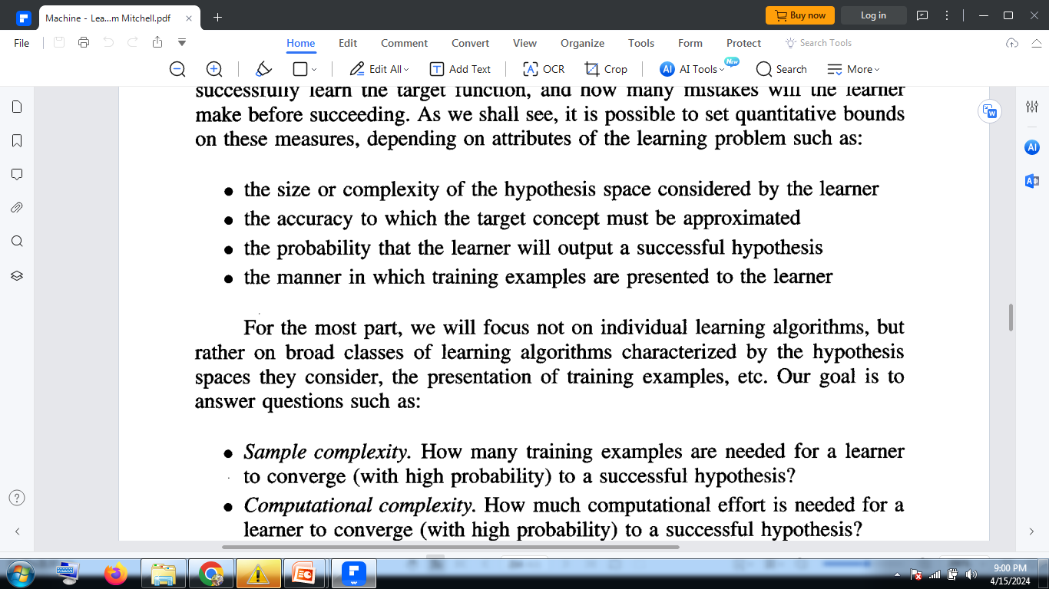
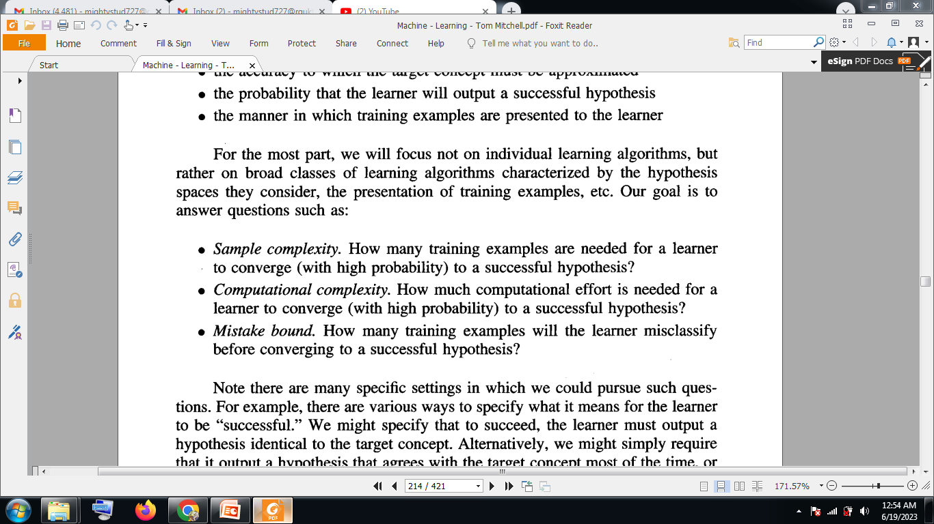
Problems/Objectives in Learning

Slide 3
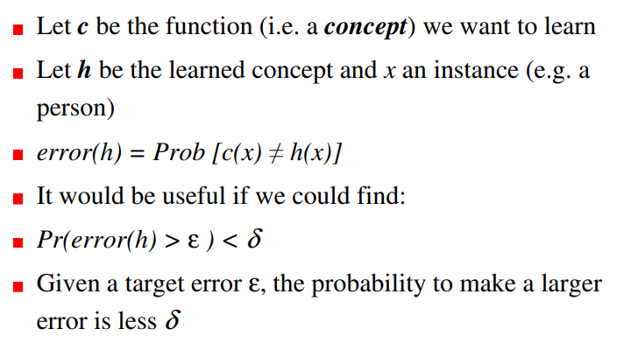
PAC Learning

Slide 4
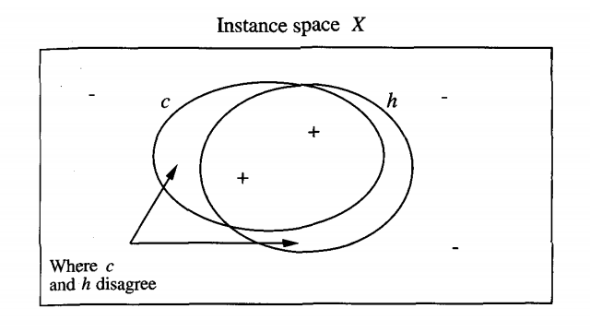
C1
C2

Slide 5
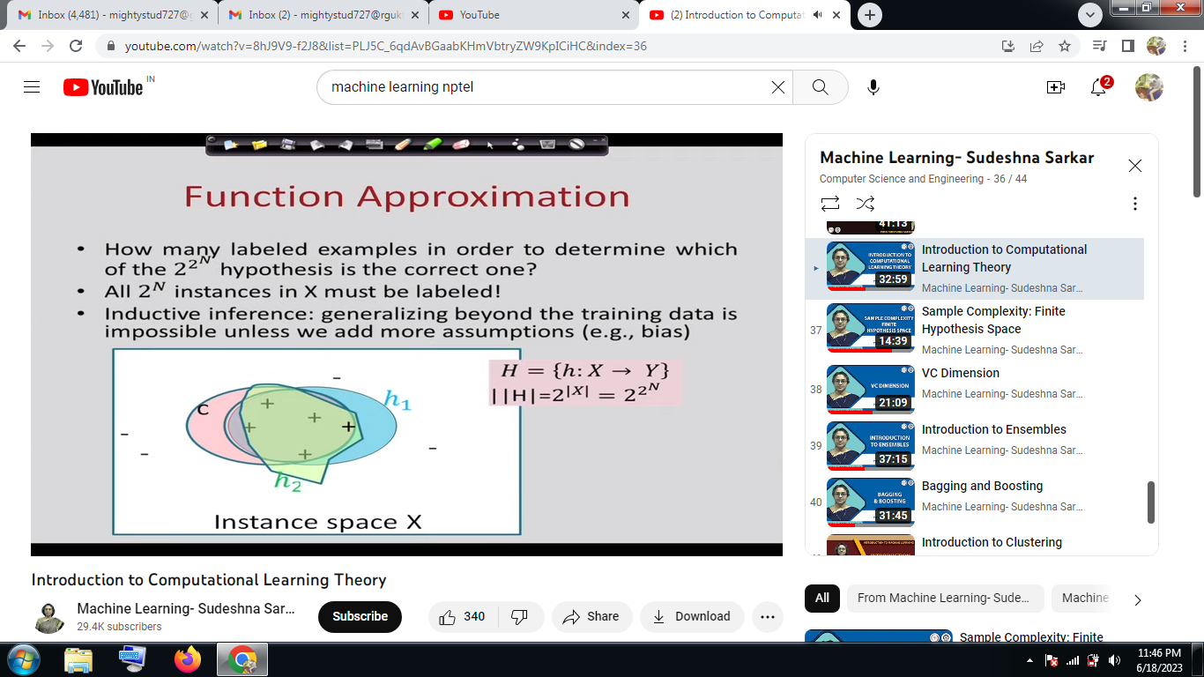

Slide 6
Ensemble Learning

Slide 7
Introduction
With One learner, decision may not be the accurate or it will not be best decision.
One may be weak or one may be strong learner
Multiple learners-combine the multiple decisions
Combining the multiple decisions are recommended to give the best decision-known as Ensembling
With Ensemble, low bias & variance is possible
Same decision with all the learners will give more confidence and low error

Slide 8
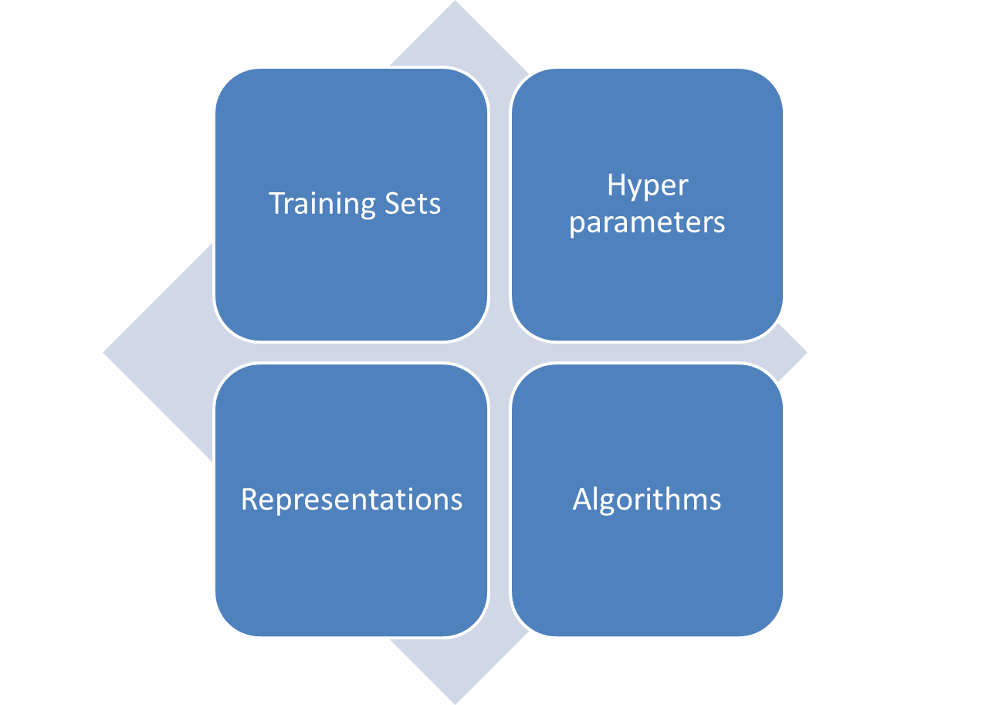
General Learners

Slide 9
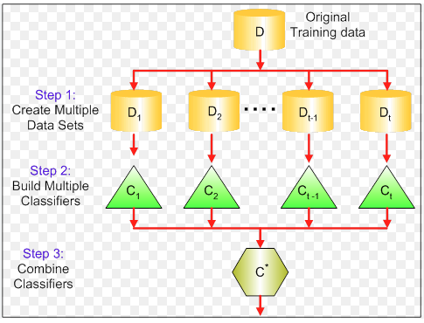
Ensemble learning

Slide 10
Bagging: It is a homogeneous weak learners’ model that learns from each other independently in parallel and combines them for determining the model average.
Boosting: It is also a homogeneous weak learners’ model but works differently from Bagging. In this model, learners learn sequentially and adaptively to improve model predictions of a learning algorithm

Slide 11
Bagging
Bagging is also called Bootstrap Aggregation and is an ensemble learning method that helps improve the performance and accuracy of an ML model.
This process takes random subsets of a dataset, with replacement, and pushes it into a classifier or a regressor. The predictions for each subset are then calculated through a majority vote for classification or averaging for regression, thus increasing the prediction accuracy.

Slide 12
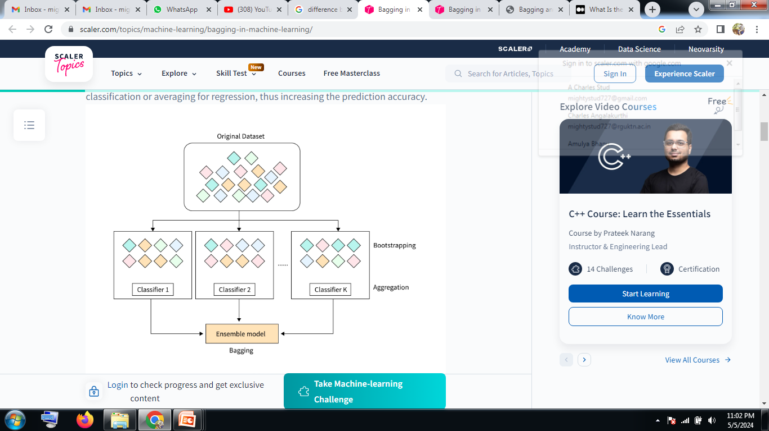

Slide 13
Boosting
Boosting is an ensemble modeling technique that attempts to build a strong classifier from the number of weak classifiers. It is done by building a model by using weak models in series.
Firstly, a model is built from the training data. Then the second model is built which tries to correct the errors present in the first model.
This procedure is continued and models are added until either the complete training data set is predicted correctly or the maximum number of models is added.

Slide 14
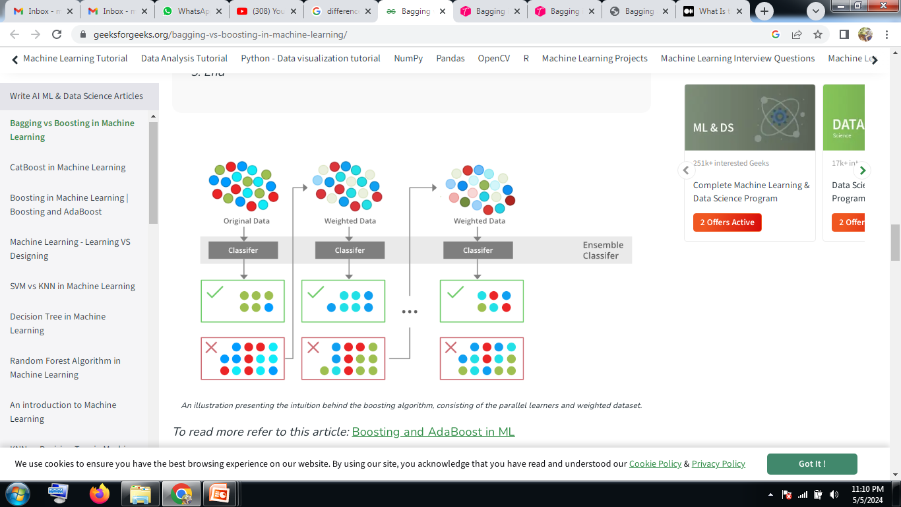

Slide 15
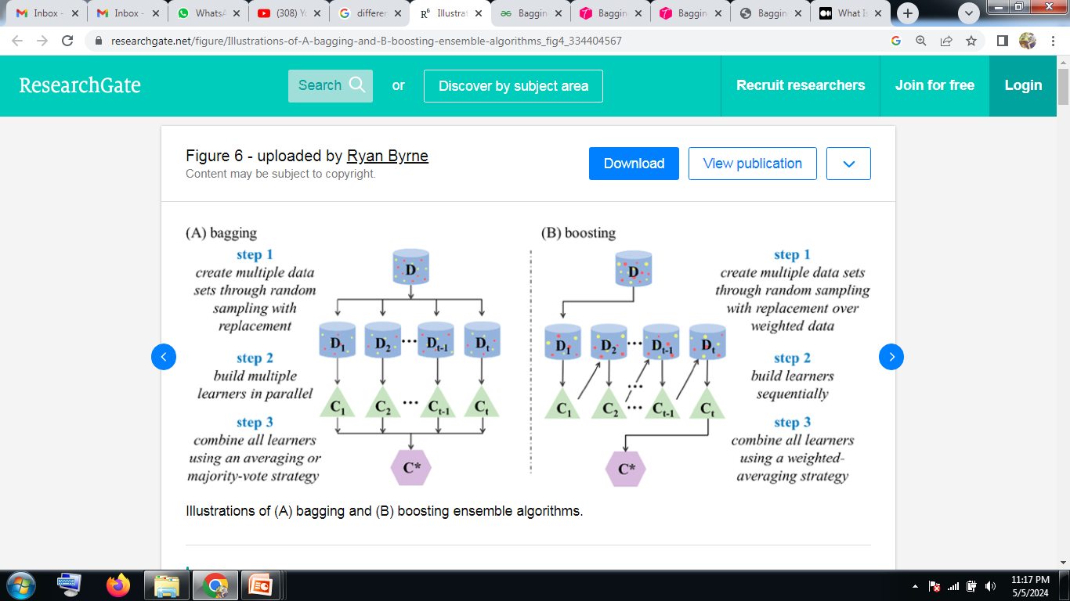

Slide 16
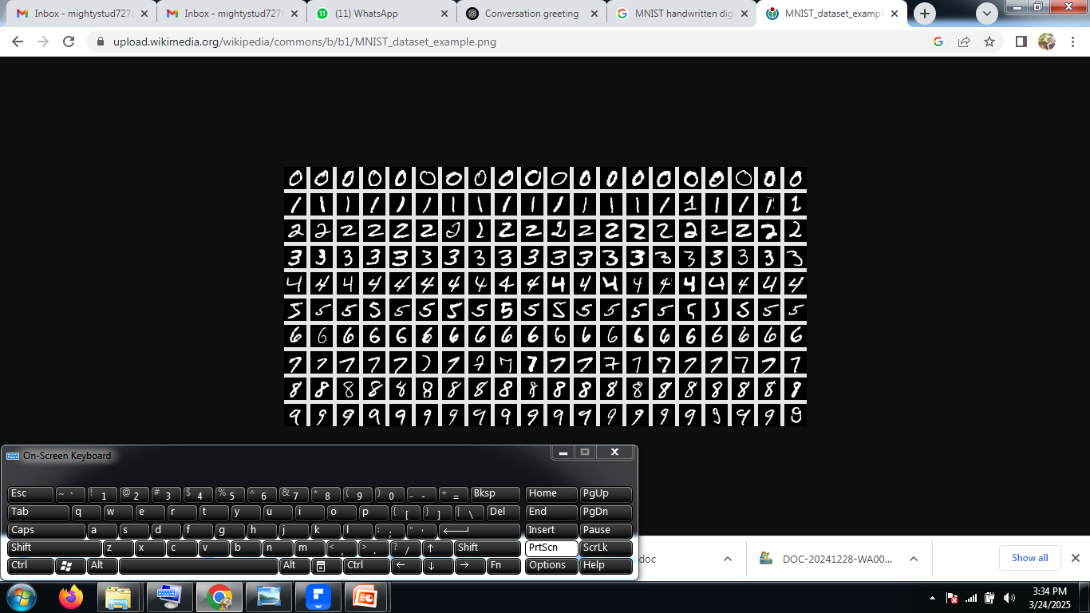
Bagging –Bootstrap Aggregation
Image classification using Random Forest--------

Slide 17
Step 1: Bootstrapping (Bagging)
Multiple Decision Trees are trained on different random subsets of the training images. Each tree sees only a fraction of the dataset (sampling with replacement), introducing randomness.
Step 2: Feature Selection at Splitting
Instead of using all 784 pixels for splitting at each node, Random Forest selects a random subset of pixels.
Step 3: Decision Trees Learning Patterns
Each tree learns decision rules based on pixel intensities to classify digits.
Example:"If pixel at (5,5) is dark and pixel at (20,20) is bright, it's likely a 3."
  Each tree independently classifies the digits.
Step 4: Majority Voting (Final Prediction)
Once all trees make their predictions, the final class is determined by majority voting.
Example:Tree 1 → Predicts 3; Tree 2 → Predicts 3; Tree 3 → Predicts 8; Tree 4 → Predicts 3
  Final Prediction = 3 (most votes)

Slide 18
AdaBoost (Adaptive Boosting) Algorithm
AdaBoost (Adaptive Boosting) is an ensemble learning technique that improves the accuracy of weak classifiers by focusing more on the mistakes made by previous models.
It combines multiple weak learners (usually decision stumps) into a strong classifier by assigning weights to misclassified samples in each iteration.
Adjusts weights to emphasize difficult-to-classify samples.
Fraud Detection Using AdaBoost
Fraud detection is a critical application of machine learning, where AdaBoost plays an important role in identifying fraudulent transactions effectively. Since fraud cases are rare compared to legitimate transactions, the challenge is to detect fraud while minimizing false positives (flagging legitimate transactions as fraud).

Slide 19
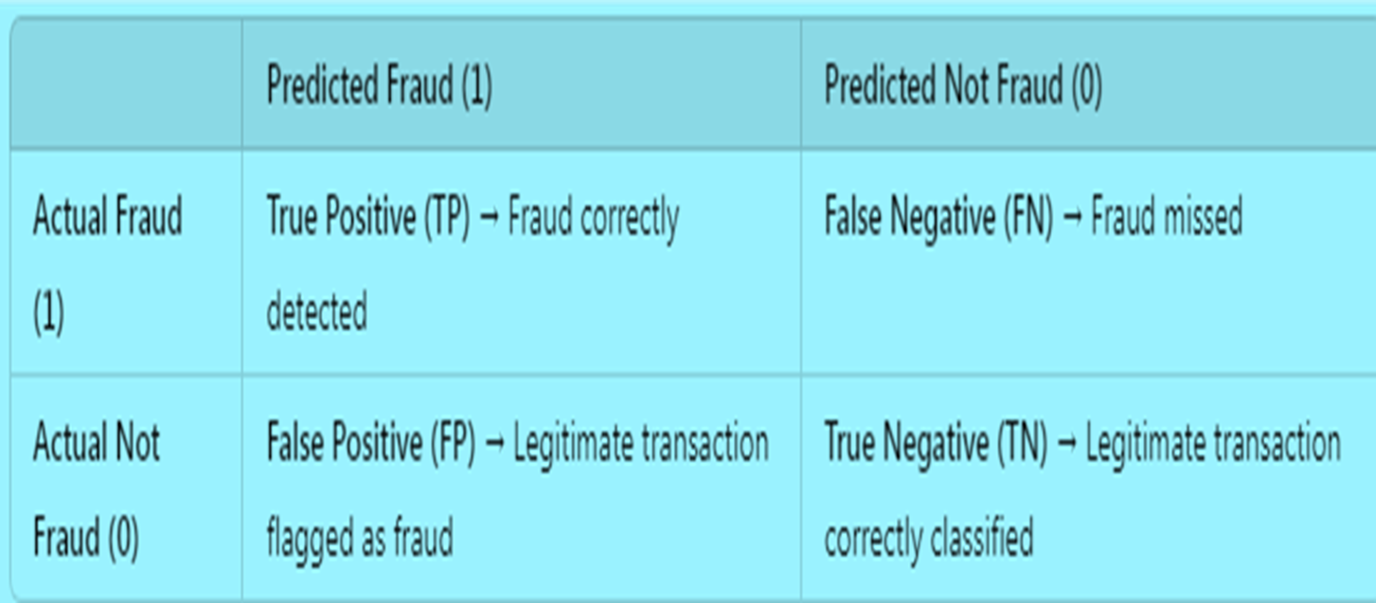

Slide 20
Clustering
Clustering is the process of dividing the entire dataset into groups or clusters. Clusters are nothing but collections of objects that are similar to each other.
Basically, clustering algorithms try to find the similarities in the data and groups the similar data points in one cluster and keep the dissimilar data points in other clusters. So, any two data points within a cluster have minimum distance and any two data points across different clusters have maximum distance.
Clustering is a very popular technique that is used to cluster data points. Clustering is basically done on similarity measures to group similar data objects together.
This similarity measure is based on distance functions such as Euclidean distance, Manhattan distance, Minkowski distance, Cosine similarity, etc. to group objects in clusters.

Slide 21
Types of Clustering:
Clustering is categorized into partition-based clustering, hierarchical-based clustering, and density-based clustering.
Partitioning Based Clustering: In this method, based on the distance the data points are partitioned into k clusters. Each partition is a cluster with similar data points. So here distance is the major parameter. An example of this is K-Means clustering.
Hierarchical Clustering: In this method, it creates a hierarchy of clusters in the form of a tree which is called a dendrogram. It creates a subset of similar data points in a tree-like structure where the root node is the complete data and the branches are developed to create the clusters. There are two approaches to Hierarchical clustering. They are agglomerative clustering which takes the bottom-up approach and divisive clustering which takes the top-down approach.
Density-Based Clustering: In this method, the distinctive groups or clusters are identified in the data considering that a cluster in the data space is a high-density region that is separated from other clusters by low-density regions. This method is also used for detecting the outliers in the data by assuming that the data points in the low-density regions could be outliers.

Slide 22
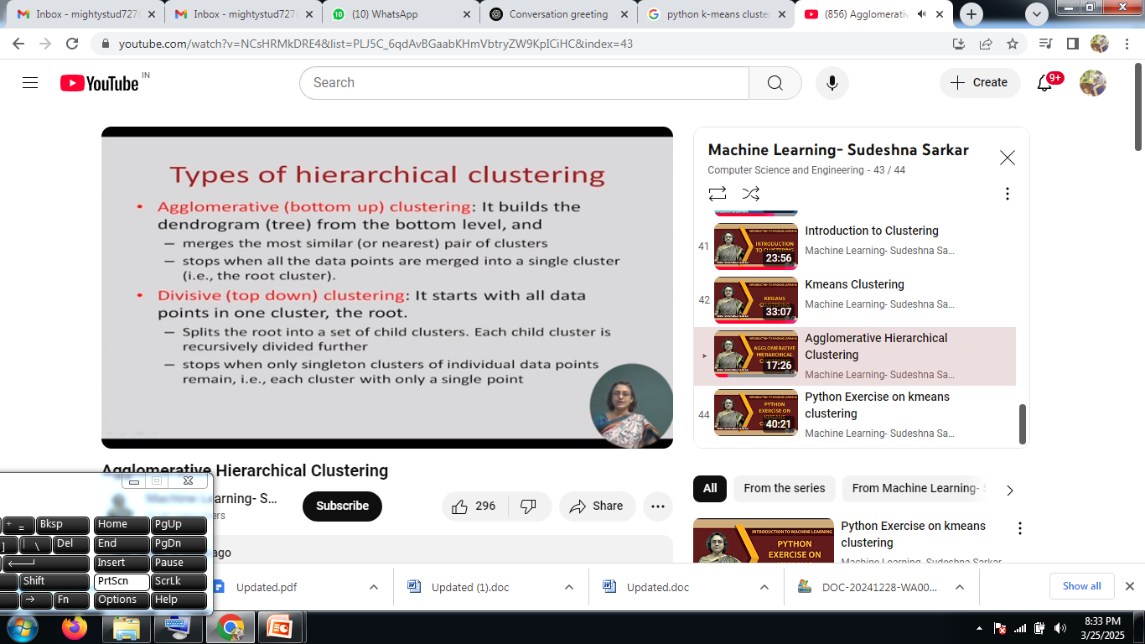

Slide 23
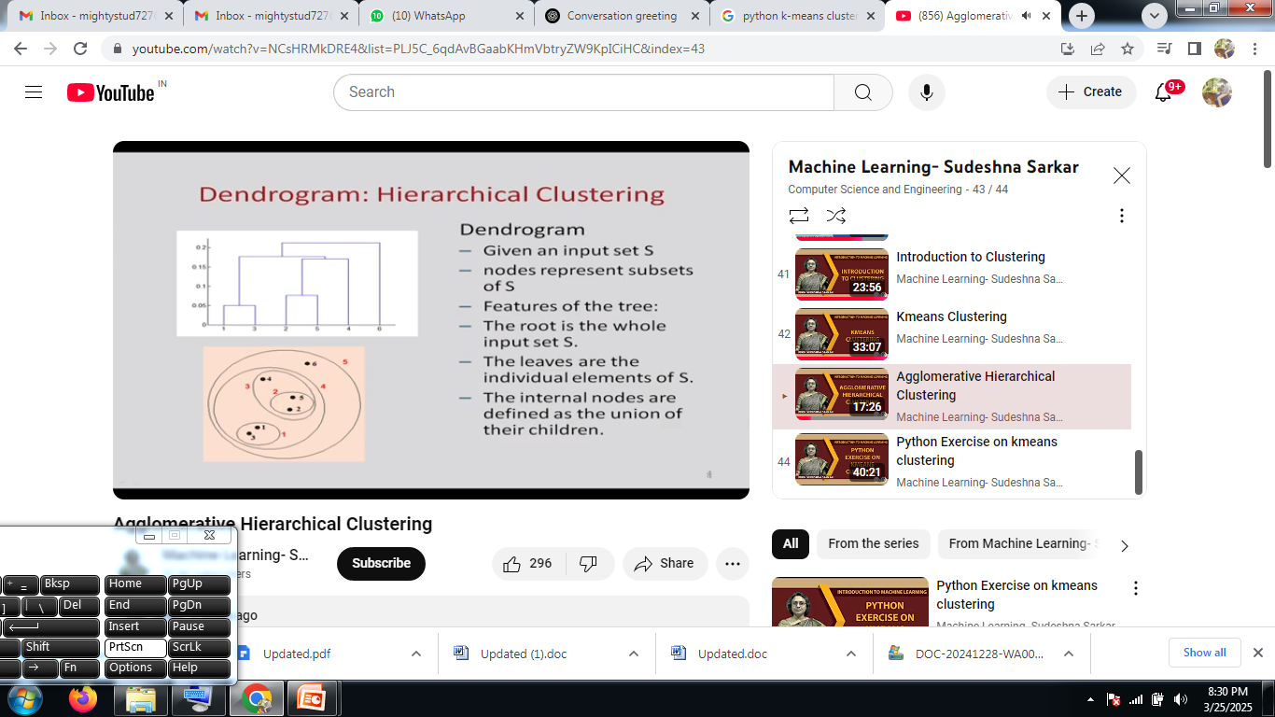

Slide 24
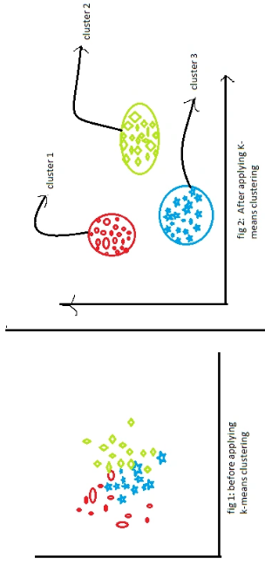
K-Means Algorithm
It is one of the most widely used clustering algorithms. It aims to partition the data into K clusters, where K is a predefined number. It iteratively assigns data points to clusters based on the proximity to the cluster centroids and updates the centroids until convergence.
The steps of the K-means algorithm can be summarized as follows:
Initialization: Choose K initial centroids randomly or using a specific initialization method. Each centroid represents the center of a cluster.
Assignment: Assign each data point to the nearest centroid based on a distance metric, typically Euclidean distance. This step forms K clusters.
Update: Recalculate the centroids of the clusters by taking the mean of all data points assigned to each cluster.
Repeat Steps 2 and 3 until convergence: Iterate the assignment and update steps until the centroids and assignments stabilize or a predefined termination condition is met (e.g., a maximum number of iterations or a small change in centroids).

Slide 25
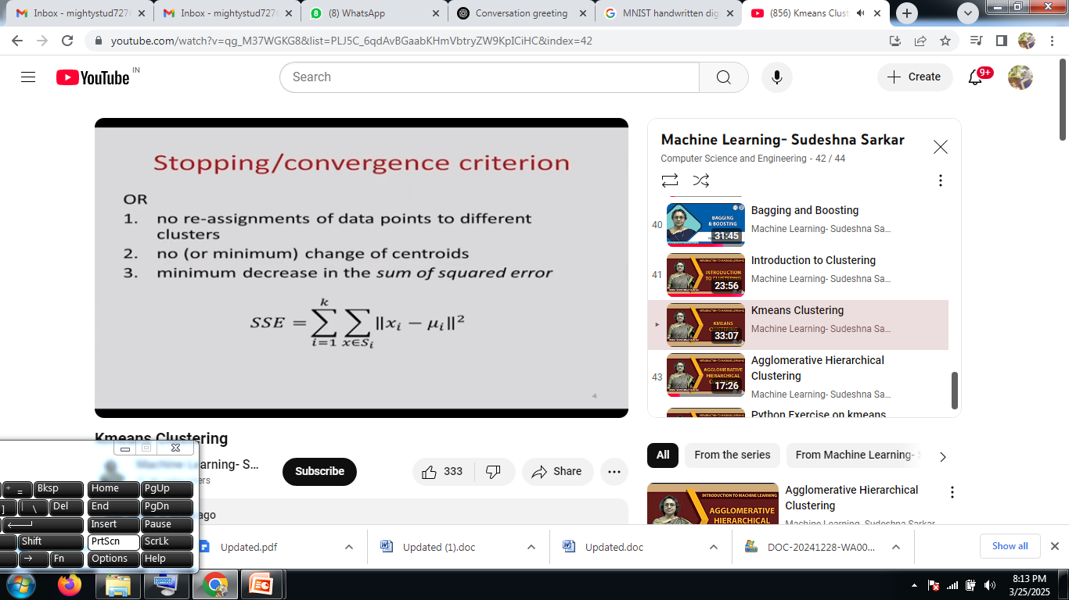

Slide 26
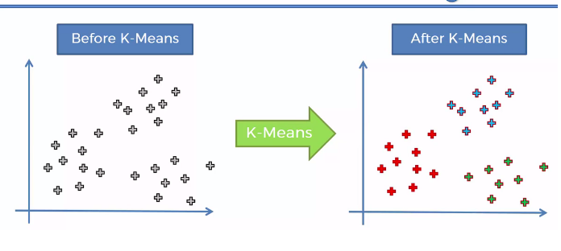
K-means clustering is a type of unsupervised learning, which is used when you have unlabeled data (i.e., data without defined categories or groups).
The goal of this algorithm is to find groups in the data, with the number of groups represented by the variable K.
The algorithm works iteratively to assign each data point to one of K groups based on the features that are provided. Data points are clustered based on feature similarity.

Slide 27
